Slide 1
2024
Detailed Project Report
BUDGET SALES ANALYSIS
AMAN PRATAP SINGH

Slide 2
1 Detailed Project Report
Problem Statement:
Our "Domain Sale" process is structured to help potential buyers purchase the domain they want immediately without the hassle of contacting the seller directly.
A seller lists a domain for sale at a specific price in our Marketplace. An interested buyer sees this domain for sale and decides to buy it.
2. Objectives:
The collection includes records for sales orders, customer information, product information, and geographical data.
In order to deduce important metrics and patterns in the dataset, this project will use the provided data to perform ETL and data analysis.
Additionally, several visualisations and reports are created to represent significant linkages.

Slide 3
2 Detailed Project Report
3. Benefits
Help in making wiser business decisions.
Aid in customer satisfaction and trend monitoring, which can serve current consumers and attract new ones.
Greater client base understanding is provided.
Facilitates seamless resource management flow.

Slide 4
3 Detailed Project Report
4. Data attributes
Customer
CustomerKey | FullName | Birthdate
Maritalstatus | Gender | YearlyIncome
TotalChildren | NumberChildrenAtHome | Education
Occupation | HouseOwnerFlag | NumberCarsOwned
DateFirstPurchase | CommuteDistance
Product
ProductKey | ProductName | Subcategory
Category | ListPrice | DaysToManufacture
ProductLine | ModelName | ProductDescription
StartDate
Territory
SalesTerritoryKey | Region | Country
Group
Sales
ProductKey | OrderDate | ShipDate
CustomerKey | PromotionKey | SalesTerritoryKey
SalesOrderNumber | SalesOrderLineNumber | OrderQuantity
UnitPrice | TotalProductCost | SalesAmount
TaxAmt

Slide 5
Detailed Project Report
Dataset information
CustomerKey: Primary key for customer dataset Birthdate: Birthdate of the customer MaritalStatus: M- Married / S - Single
Gender: M – Male / F – Female
TotalChildren: Total number of children
NumberChildrenAtHome: Number of children staying along with their parents
Education: Education qualification
Occupation: Present occupation
HouseOwnerFlag: 1– Owns house / 0- Doesn’t have a permanent
address
NumberCarsOwned: Number of cars owned by the customer DateFirstPurchase: First date of order by the customer ProductKey: Primary Key for the product dataset ProductName: Product name with colour of the product Subcategory: Sub category name of the product
Category: Category name of the product
ListPrice: Sale price of the product
DaysToManufacture: Days to manufacture the product after receiving the order
ProductLine: Product line name
ModelName: Model name of the product
ProductDescription: more details about the product

Slide 6
5 Detailed Project Report
SalesTerritoryKey: Primary Key of the Territory dataset
Region: Region name of the order Country: Country name of the order OrderDate: Date of the order received
ShipDate: Date when the order left the factory for export SalesOrderNumber: Invoice number of the order OrderQuantity: Number of quantities ordered for a product UnitPrice: Per unit sale price of the product TotalProductCost: Cost of the product
SalesAmount: Total sales price of the product
TaxAmt: Tax collected for the product sold

Slide 7









6 Detailed Project Report
5. Architecture
Collect Raw Data
Importing Libraries
Load Dataset
Merging Data
Exploring Data
Adding Columns
Handling Missing Data
Assessing Data
Modeling
Creating Measures
Power BI Report
Insights
Deployment
Documentation
Collect Raw Data - This step involves extracting the data from different sources relevant to the problem statement or obtaining data from the client
Importing Libraries – Import analysis related python libraries example – Pandas, Numpy, Plotly, datetime etc
Data Wrangling – Contains following steps gathering data, assessing data, handling missing data and adding columns

Slide 8
7 Detailed Project Report
Exploring Data – Once the data is loaded and pre- processed, we preform data analysis using python libraries and Business Intelligence tools like Power BI
Data Modelling - Data Modelling is one of the features used to connect multiple data sources in BI tool using a relationship.
A relationship defines how data sources are connected with each other and you can create interesting data visualizations on multiple data sources
Deployment - The prepared visualizations are deployed on the powerbi.microsoft.com site. Where they will be available publicly

Slide 9

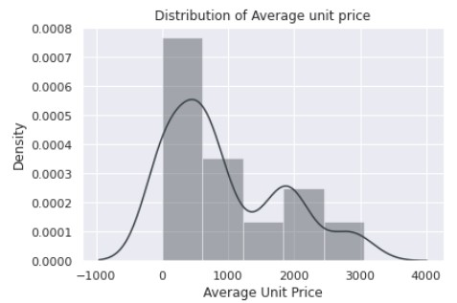

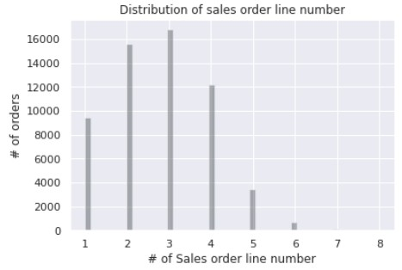
8 Detailed Project Report
6. Insights
1. Product Price per unit Distribution
 | According to the above distribution plot we can conclude that maximum of the product unit price is below $1000
2. Sales order line number distribution
 | Most of the time three to two products are ordered in a single order

Slide 10

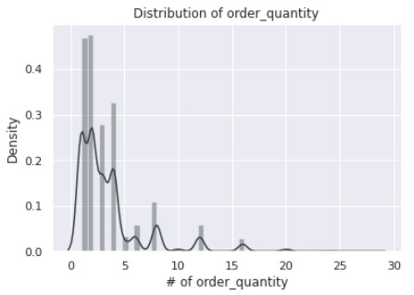

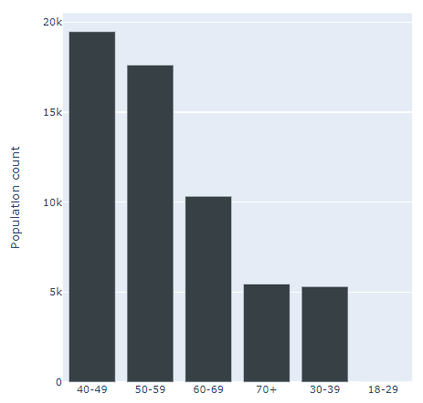

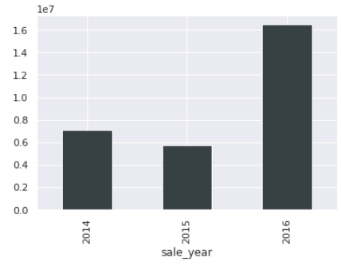
9 Detailed Project Report
3. Sales order quantity distribution
 | Maximum quantity ordered for a product is below 5
4. Age distribution
 | A sizable portion of the clientele is made up of people between the ages of 40 and 59
5. Year wise sales
 | The year 2016 saw an exponential surge in sales

Slide 11

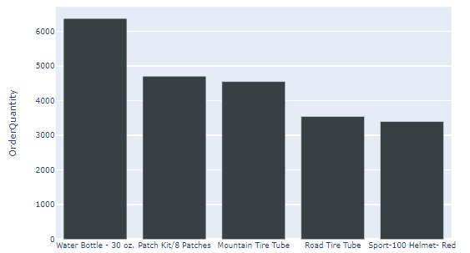

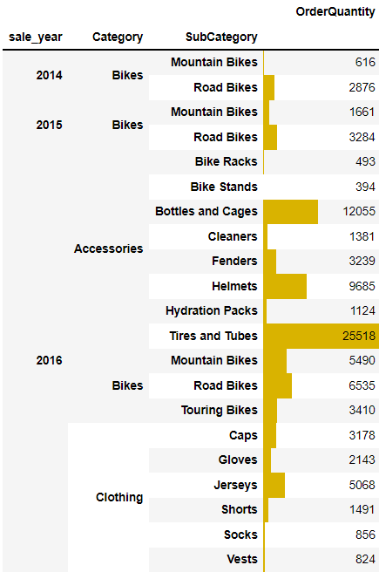
10 Detailed Project Report
6. Top 5 selling products
7. Quantity ordered based on category and subcategory from 2014 to 2016

Slide 12

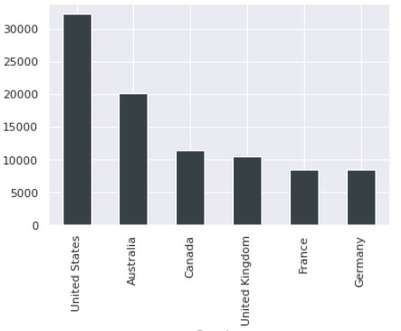

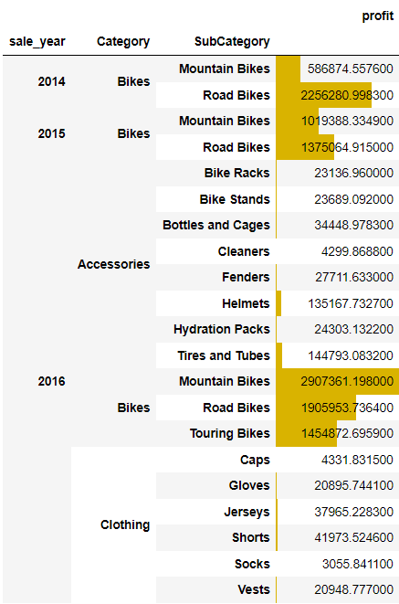
11 Detailed Project Report
8. Country wise quantity ordered
 | High quantity of products is ordered from Australia and United States
9. Overall profit based on order year, category and subcategory
Major Profit is contributed by the Bike Category

Slide 13

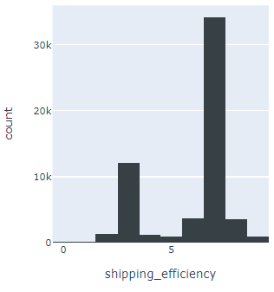

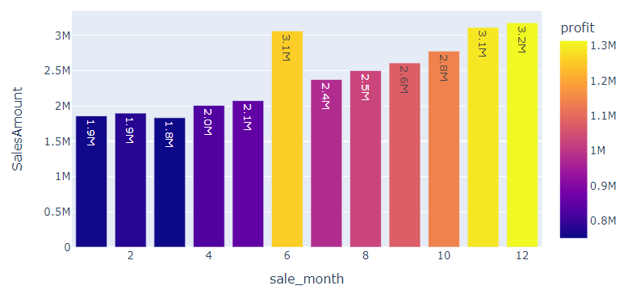
12 Detailed Project Report
10.How efficient are the logistics?
 | The average order has a gap of 7 days between the day the order is ready for export from the factory and the date it was shipped Management must work to reduce this gap toward 3 days
11.What was the best month for sales? How much was earned that month?
Maximum profit earned in the months of June, November, and December

Slide 14

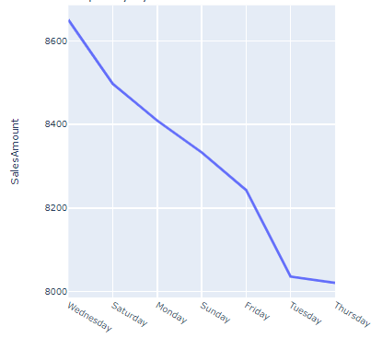

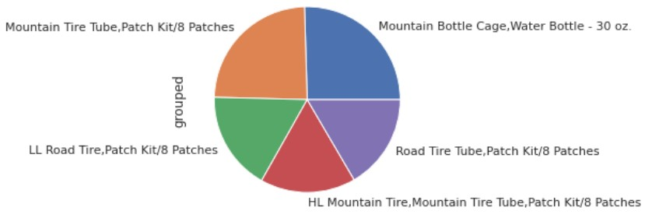
13 Detailed Project Report
12.What time should we display advertisement to maximize likelihood of customer is buying product?
 | High sales orders are seen on Wednesday and Saturday; therefore, we can promote our product during these workweek
13.Which products are most often sold together?
The above product can be sold in a bundle or a combined package for discount

Slide 15

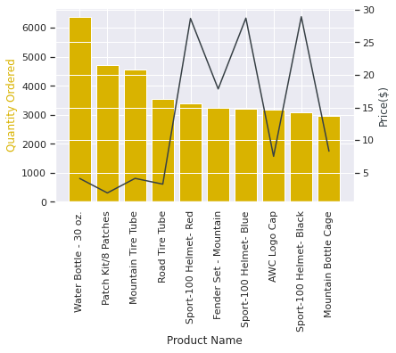


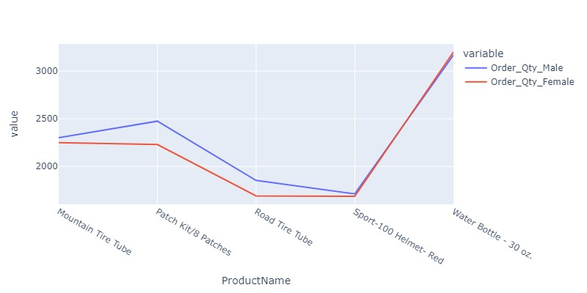
14 Detailed Project Report
14.Which product sold the most? why do you think it sold the most?
 | There is a high negative correlation between Price and number of Quantity ordered we can conclude that low price product has high demand
15.Compare most ordered product by gender

Slide 16

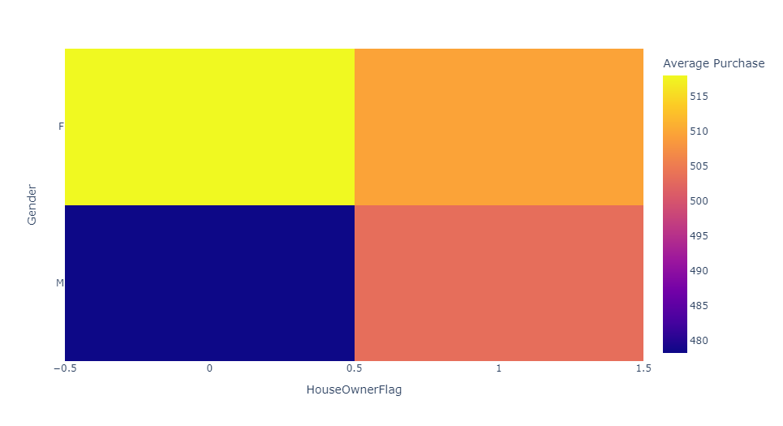

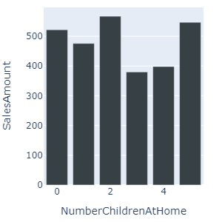
15 Detailed Project Report
16.Does Gender and home ownership matter in order purchasing
It's interesting to note that the average amount spent by men without permanent addresses is low, whilst the average amount spent by women without permanent addresses is higher
17.Number of children and Purchase correlation
 | Purchase among customers with number of children, 2 and 5, are high

Slide 17

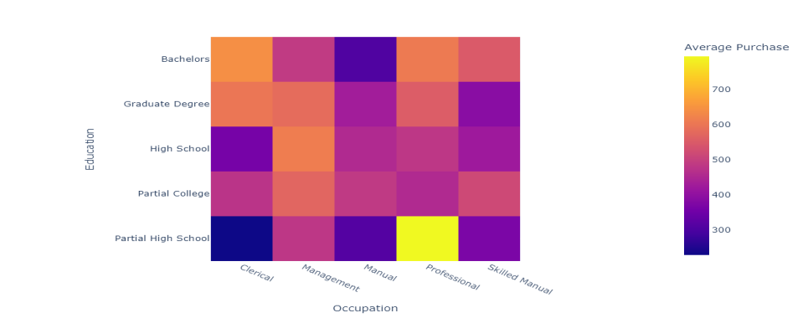

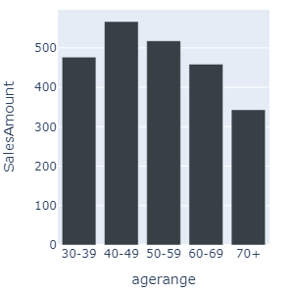

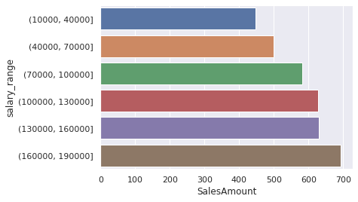
16 Detailed Project Report
18.Occupation and purchase correlation
Purchases by Professional and Management customers are comparatively high
19.Which age group has produced the most revenue?
 | Age range of 40-49 and 50- 59 is shows high demand compared to other age group
20.Yearly income range and purchase correlation
 | High salary range leads to increase in revenue

Slide 18


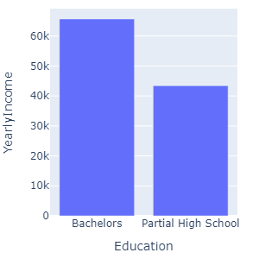
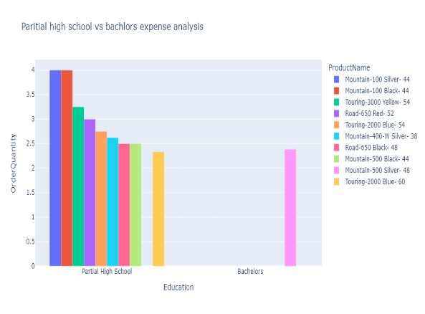

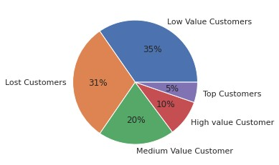
17 Detailed Project Report
21. Partial high school vs bachelors income mean and most ordered product
Customers with a high school diploma and modest annual income buy more products than people with bachelor's degrees
22.Customer segmentation
 | According to the customer segmentation described above, approximately 15% of our clients are high value clients, whereas the majority of our clientele are low value and lost clients

Slide 19
19 Detailed Project Report
7. Key Performance Indicator
Sales trend line
Cost trend line
Average unit cost and price
Revenue generated by Subcategory
Sales by Product Line
Revenue contribution by region
Profit contribution by region
Profit % by region
Current year profit margin vs difference in last year’s profit margin
Total orders
Total revenue
Actual sales and target sales matrix
Customer retention line chart
Monthly spending trend
Average monthly spend distribution

Slide 20
20 Detailed Project Report
Conclusion
A sizable portion of the clientele is made up of people between the ages of 40 and 59
The year 2016 saw an exponential surge in sales
High quantity of products is ordered from Australia and United States
Major Profit is contributed by the Bike Category
The average order has a gap of 7 days between the day the order is ready for export from the factory and the date it was
shipped
Maximum profit earned in the months of June, November, and December
High sales orders are seen on Wednesday and Saturday, when compared to other weekdays
There is a high negative correlation between Price and number of Quantity ordered

Slide 21
21 Detailed Project Report
The average amount spent by men without permanent addresses is low, whilst the average amount spent by women without permanent addresses is higher
Age range of 40-49 and 50-59 is shows high demand compared to other age group
High salary range leads to increase in revenue
Customers with a high school diploma and modest annual income buy more products than people with bachelor's degrees
According to the customer segmentation described above, approximately 15% of our clients are high value clients, whereas the majority of our clientele are low value and lost clients
Client retention in 2014 was subpar
2016 brought about a slight improvement in retention

Slide 22
22 Detailed Project Report
9. Q & A
Q1) What’s the source of data?
The Dataset was taken from iNeuron’s Provided Project
Description Document
Q2) What was the type of data?
The data was the combination of numerical and Categorical values
Q 3) What’s the complete flow you followed in this Project?
Refer page 4 for better Understandings
Q4) What techniques were you using for data?
Removing unwanted attributes
Visualizing relation of independent variables with each other
Cleaning data by removing column with missing values
Converting Numerical data into Categorical values
Q 6) What were the libraries that you used in Python?
I used Pandas, NumPy, Matplotlib, Seaborn and Plotly libraries

